Slide 1

US Public Education Crisis Post-COVID
By: Bryan Pritsker
Link to Tableau Public Story:
https://public.tableau.com/views/TeacherQuitsandVacancies/Story1?:language=en-US&:sid=&:display_count=n&:origin=viz_share_link

Slide 2
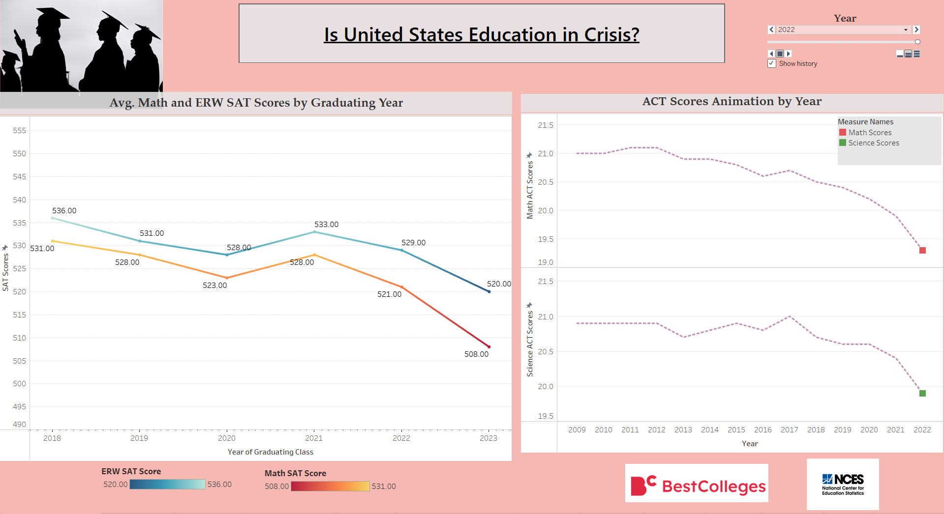

Slide 3
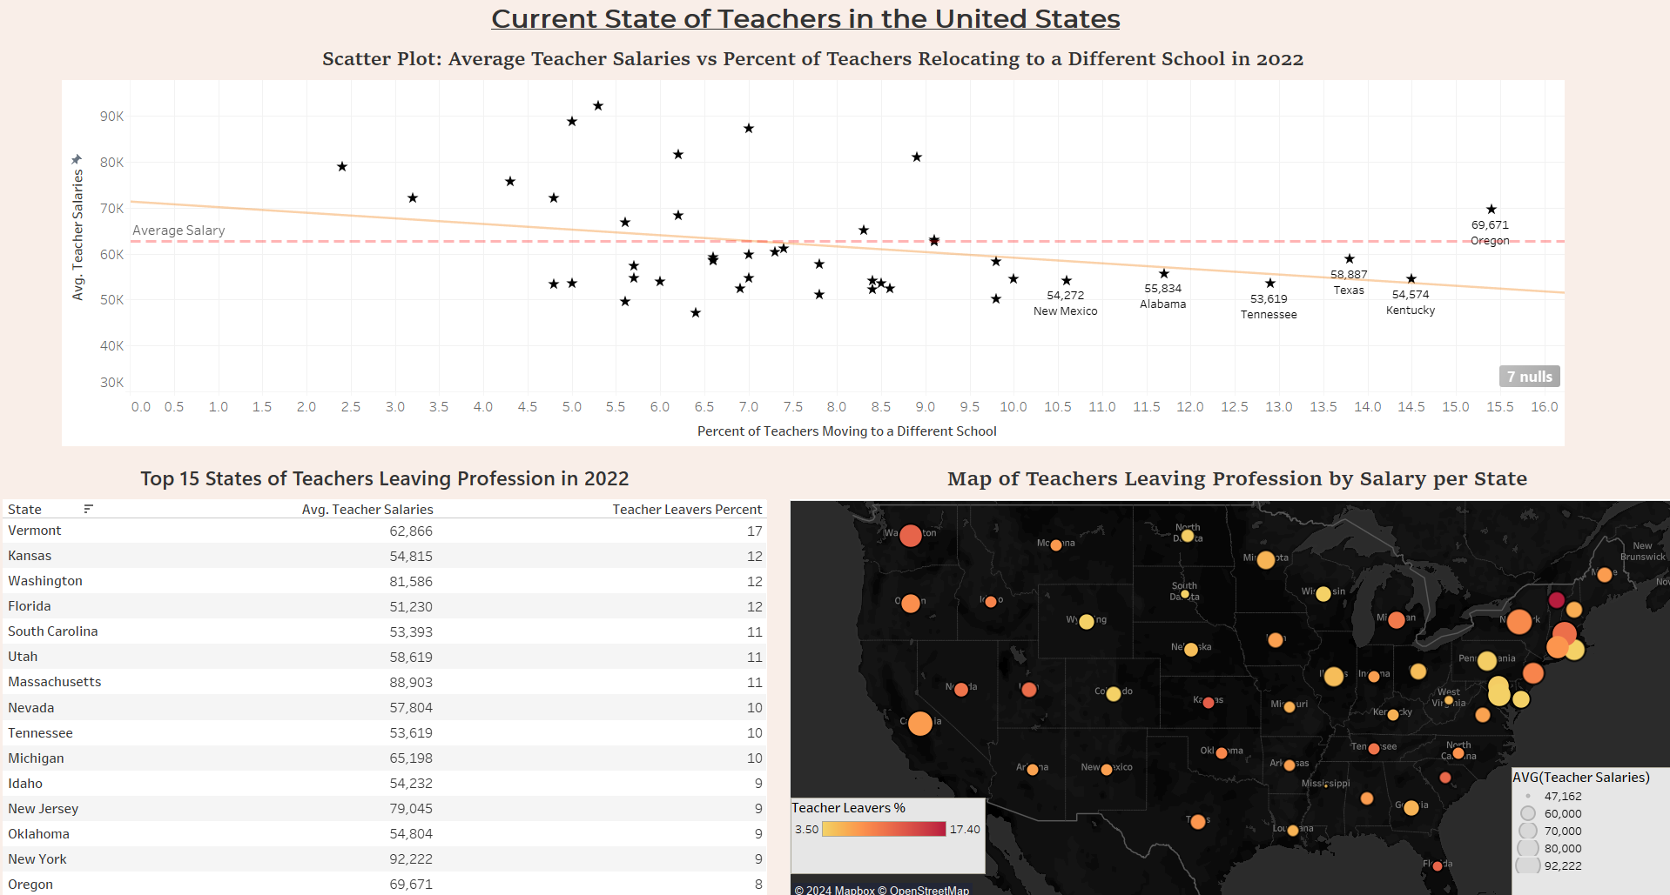

Slide 4
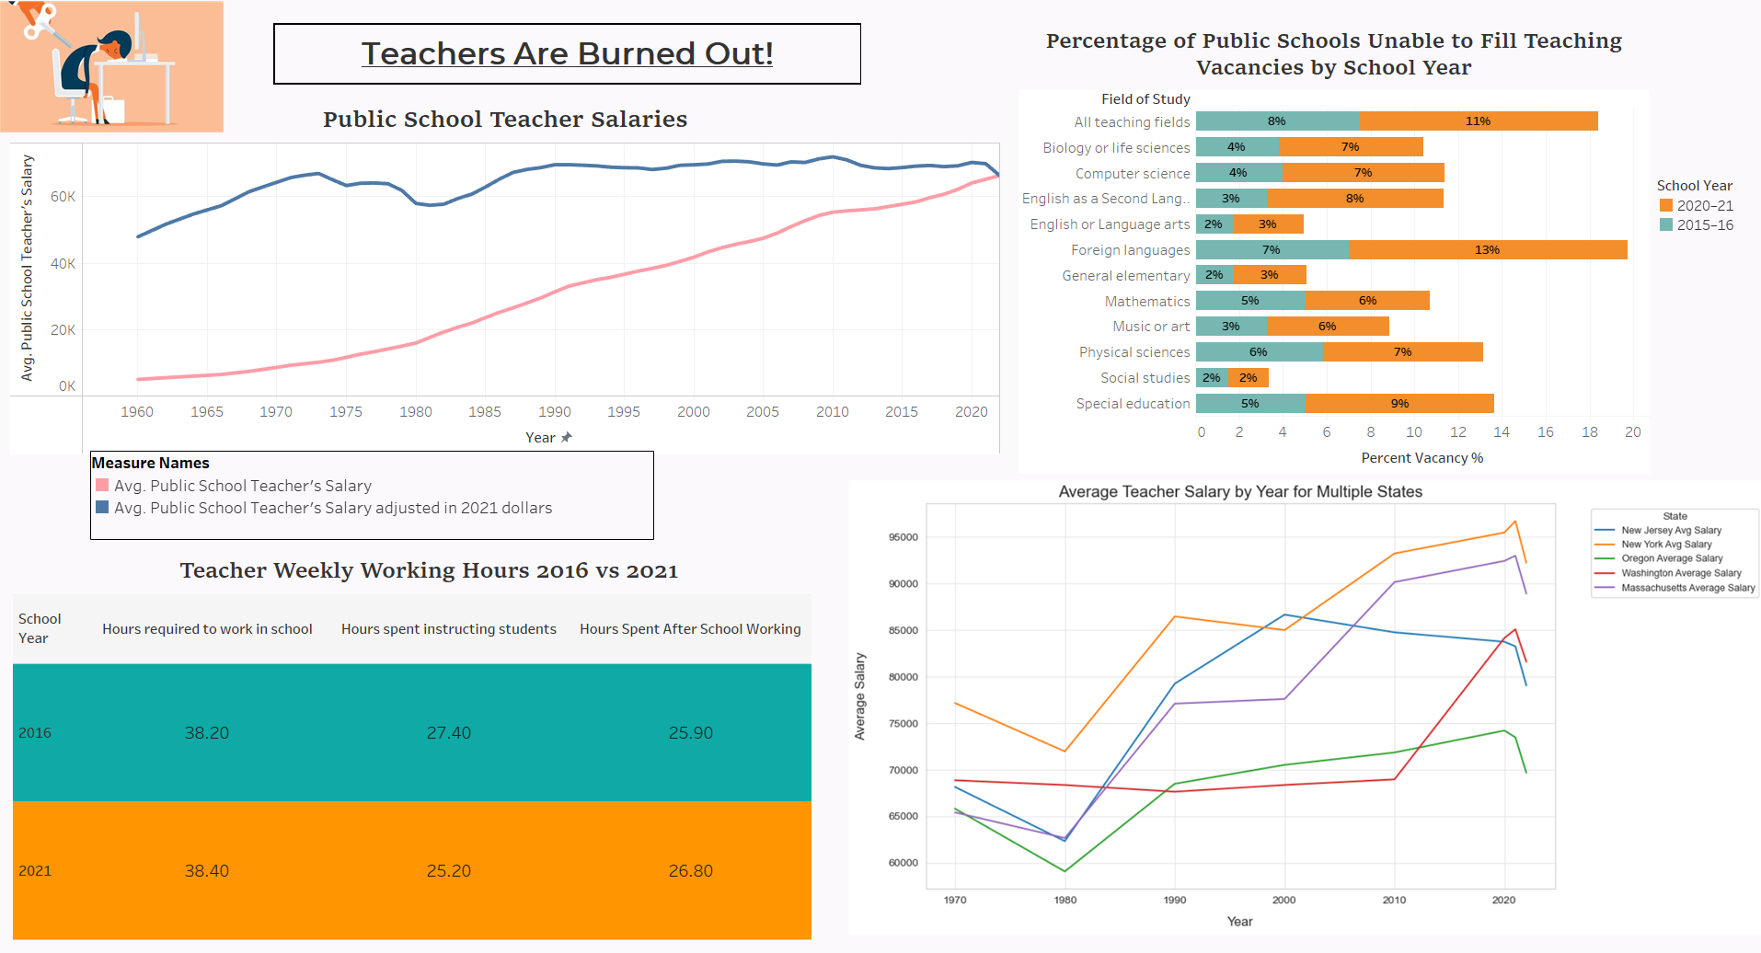

Slide 5
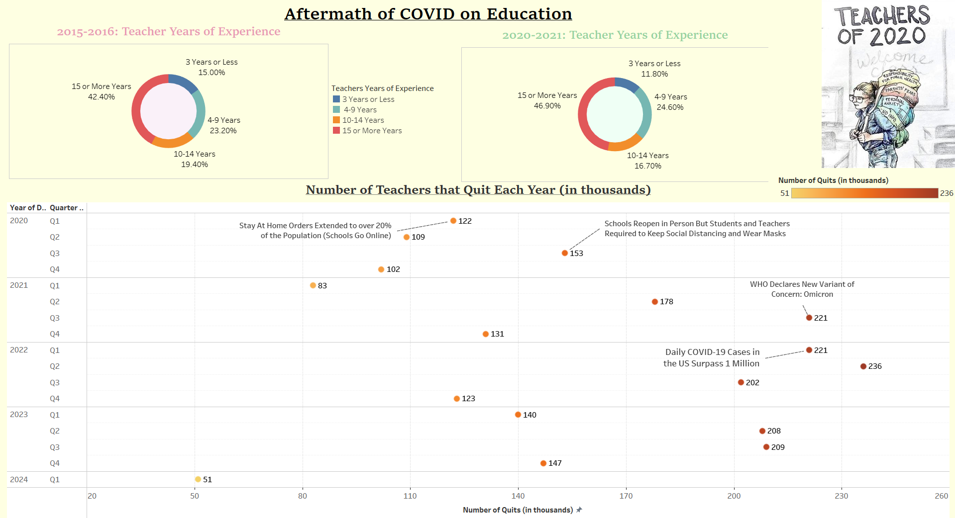

Slide 6
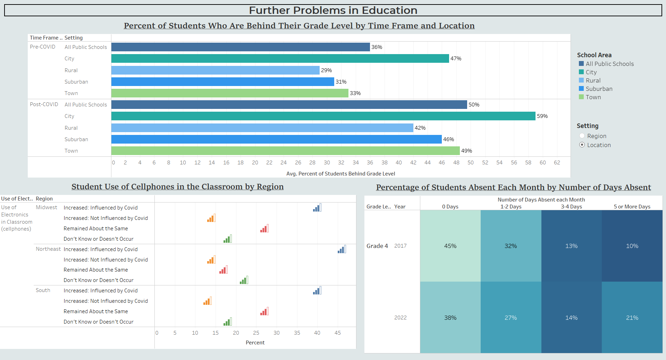

Slide 7
